Slide 1
Relational model and keys

Slide 2
Content
1. ER Modeling fundamentals
2. mapping ERD--> relations
3. 1NF – 3NF, BCNF
4.Practice normalizing

Slide 3
Entity/Relationship Modelling
E/R Modelling is used
for conceptual design
  Entities - objects or items of interest
  Attributes – properties
of an entity
  Relationships - links between entities
For example, in a University database we might have entities for Students, Modules and Lecturers
  Students might have attributes such as their ID, Name, and Course
  Students could have relationships with Modules (enrolment) and Lecturers (tutor/tutee)

Slide 4
Relational Data Integrity
Domains
Candidate and Primary Keys
Foreign keys
Candidate keys
Uniqueness
Minimality
ID | First | Last
S139 | Alan | Carr
S140 | Jo | Brand
S141 | Alan | Davies
S142 | Jimmy | Carr

Slide 5
Foreign Keys
Link data
Referential integrity
Department
Employee
DID | DName
13 | Marketing
14 | Accounts
15 | Personnel
EID | EName | DID
15 | John Smith | 13
16 | Mary Brown | 14
17 | Mark Jones | 13
18 | Jane Smith | NULL

Slide 6
Entity/Relationship Diagrams
E/R Models are often represented as E/R diagrams that
  Give a conceptual view of the database
  Are independent of the
choice of DBMS
  Can identify some problems in a design
Lecturer
ID
Name
Course
Tutors
Student
Module
Studies

Slide 7
Diagramming Entities
Entities represent objects or things of interest
In E/R Diagrams, we will represent Entities as boxes with rounded corners
The box is labelled with the name of the class of objects represented by that entity
Lecturer
ID
Name
Course
Tutors
Student
Module
Studies

Slide 8
Diagramming Attributes
Attributes are facts, aspects, properties, or details about an entity
In an E/R Diagram attributes are drawn as ovals
Each attribute is linked to its entity by a line
The name of the attribute is written in the oval
Lecturer
ID
Name
Course
Tutors
Student
Module
Studies

Slide 9
Relationships
Relationships are an association between two or more entities
Relationships have
  A name
  A set of entities that participate in them
  A degree - the number of entities that participate (most have degree 2)
  A cardinality ratio
60

Slide 10
Cardinality Ratios
One to one (1:1)
  Each lecturer has a unique office & offices are single occupancy
One to many (1:M)
  A lecturer may tutor many students, but each student has just one tutor
Many to many (M:N)
  Each student takes several modules, and each module is taken by several students

Slide 11
Entity/Relationship Diagrams
Relationships are shown as links between two entities
The name is given in a diamond box
The ends of the link show cardinality
Lecturer
ID
Name
Course
Tutors
Student
Module
Studies
One
Many

Slide 12
Entity/Relationship Diagrams
Final E/R diagram looks
like this:
Lecturer
ID
Name
Course
Tutors
Student
Module
Studies

Slide 13
Making E/R Models
To make an E/R model
you need to identify
  Entities
  Attributes
  Relationships
  Cardinality ratios
We obtain these from a problem description
General guidelines
  Since entities are things or objects they are often nouns in the description
  Attributes are facts or properties, and so are often nouns also
  Verbs often describe relationships between entities

Slide 14
Example
A university consists of a number of departments. Each department offers several courses. A number of modules make up each course. Students enroll in a particular course and take modules towards the completion of that course. Each module is taught by a lecturer from the appropriate department (several lecturer work in the same department), and each lecturer tutors a group of students. A lecturer can teach more than one module but can work only in one department.

Slide 15
Example - Entities
A university consists of a number of departments. Each department offers several courses. A number of modules make up each course. Students enroll in a particular course and take modules towards the completion of that course. Each module is taught by a lecturer from the appropriate department (several lecturer work in the same department), and each lecturer tutors a group of students. A lecturer can teach more than one module but can work only in one department.
Entities – Department, Course, Module, Student, Lecturer

Slide 16
Example - Relationships
A university consists of a number of departments. Each department offers several courses. A number of modules make up each course. Students enroll in a particular course and take modules towards the completion of that course. Each module is taught by a lecturer from the appropriate department (several lecturer work in the same department), and each lecturer tutors a group of students. A lecturer can teach more than one module but can work only in one department.
Entities – Department, Course, Module, Student, Lecturer
Relationships – Offers, Make Up, Enroll, Take,
Taught By, From The, Tutors
67

Slide 17
Example – E/R Diagram
Entities: Department, Course, Module, Lecturer, Student
Department
Course
Module
Lecturer
Student

Slide 18
Example – E/R Diagram
Each Department offers several Courses
Offers
Department
Course
Module
Lecturer
Student

Slide 19
Example – E/R Diagram
A number of modules make up each Course
Offers
Department
Course
Includes
Module
Lecturer
Student
70

Slide 20
Example – E/R Diagram
Students enrol in a particular course
Offers
Department
Course
Includes
Module
Lecturer
Enrols
Student

Slide 21
Example – E/R Diagram
Students take several modules
Offers
Department
Course
Includes
Module
Lecturer
Takes
Enrols
Student

Slide 22
Example – E/R Diagram
Each Module is taught by a Lecturer
Offers
Department
Course
Includes
Module
Taught By
Lecturer
Takes
Enrols
Student

Slide 23
Example – E/R Diagram
Each department employs a number of lecturers
Offers
Department
Employs
Course
Includes
Module
Taught By
Lecturer
Takes
Enrols
Student

Slide 24
Example – E/R Diagram
Each Lecturer tutors a number of Students
Offers
Department
Employs
Course
Includes
Module
Taught By
Lecturer
Takes
Enrols
Student
Tutors

Slide 25
Example – E/R Diagram
The completed diagram. All that remains is to remove M:M relationships
Offers
Department
Employs
Course
Includes
Module
Taught By
Lecturer
Takes
Enrols
Student
Tutors

Slide 26
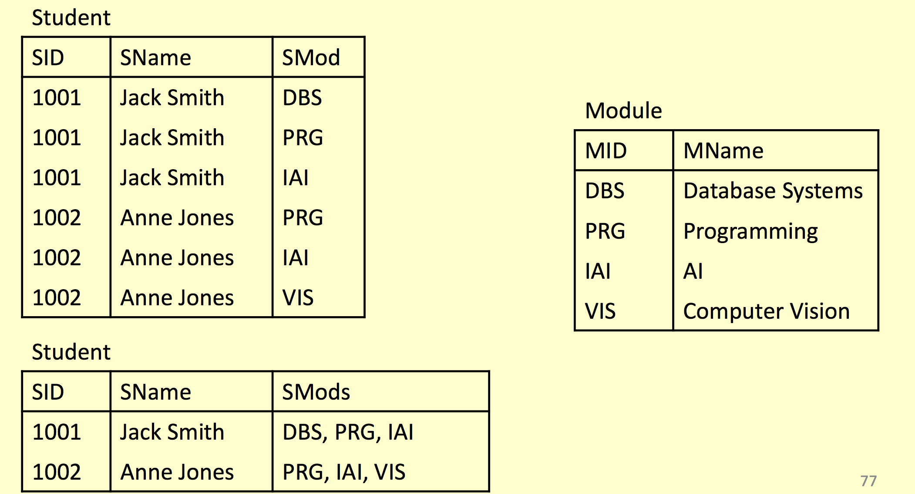
Removing M:N Relationships
Many to many relationships are difficult to represent in a database:

Slide 27
Removing M:N Relationships
Many to many relationships are difficult to represent in a database
We can split a many to many relationship into two one to many relationships
An additional entity is created to represent the M:N relationship

Slide 28
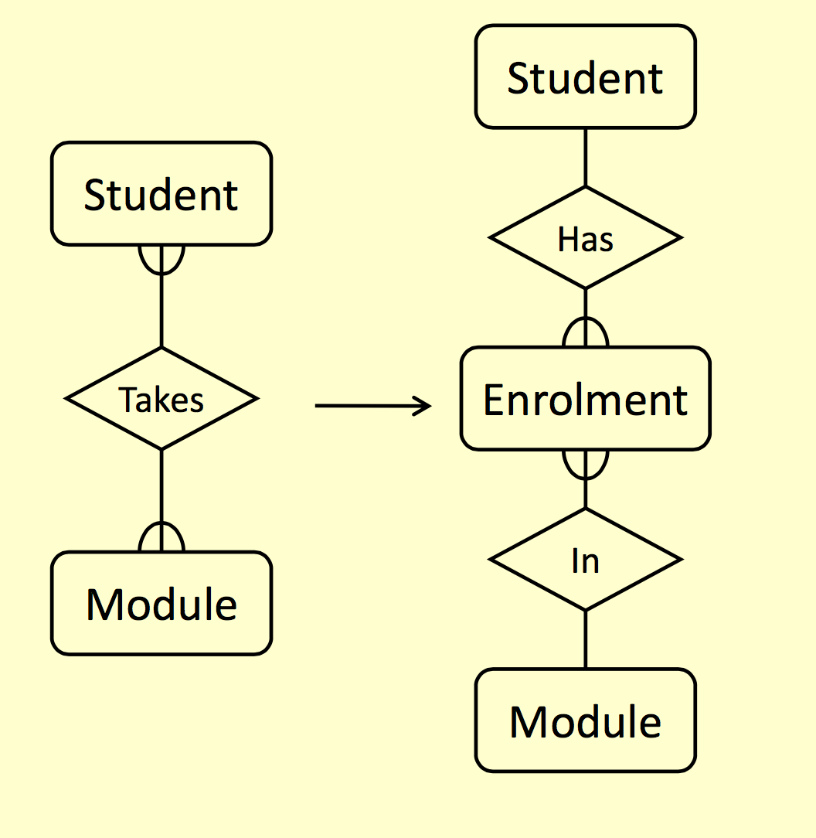
Removing M:N Relationships

Slide 29
Entities and Attributes
Sometimes it is hard to tell if something should be an entity or an attribute
  They both represent objects or facts about the world
  They are both often represented by nouns in descriptions
General guidelines
  Entities can have attributes but attributes have no smaller parts
  Entities can have relationships between them, but an attribute belongs to a single entity

Slide 30
Example
We want to represent information about products in a database. Each product has a description, a price and a supplier. Suppliers have addresses, phone numbers, and names. Each address is made up of a street address, a city, and a postcode.
80

Slide 31
Example - Entities/Attributes
Entities or attributes:
  product
  description
  price
  supplier
  address
  phone number
  name
  street address
  city
  postcode
Products, suppliers, and addresses all have smaller parts so we make them entities
The others have no smaller parts and belong to a single entity

Slide 32
Example - E/R Diagram
Price
Description
Product
Street address
Name
Supplier
Address
City
Phone number
Postcode

Slide 33
Example - Relationships
Each product has a
supplier
  Each product has a single supplier but there is nothing to stop a supplier supplying many products
  A many to one relationship
Each supplier has an
address
  A supplier has a single address
  It does not seem sensible for two different suppliers to have the same address
  A one to one
relationship

Slide 34
Example - E/R Diagram
Price
Description
Product
Has A
Street address
Name
Supplier
Has An
Address
City
Phone number
Postcode

Slide 35
One to One Relationships
Some relationships between entities, A and B, might be redundant if
  It is a 1:1 relationship
between A and B
  Every A is related to a B and every B is related to an A
Example - the supplier-
address relationship
  Is one to one
  Every supplier has an address
  We don’t need addresses that are not related to a supplier

Slide 36
Redundant Relationships
We can merge the two entities that take part in a redundant relationship together
  They become a single
entity
  The new entity has all the attributes of the old ones
a
x
b
A
B
y
c
z
a
x
b
AB
y
c
z

Slide 37
Example - E/R Diagram
Price
Description
Product
Has A
Name
Supplier
City
Phone number
Postcode
Street address

Slide 38
Making E/R Diagrams
From a description of the requirements identify the
  Entities
  Attributes
  Relationships
  Cardinality ratios of the relationships
Draw the E/R diagram
and then
  Look at one to one relationships as they might be redundant
  Look at many to many relationships as they will often need to be split into two one to many links, using an intermediate entity

Slide 39
Debugging Designs
With a bit of practice E/R diagrams can be used to plan queries
  You can look at the diagram and figure out how to find useful information
  If you can’t find the information you need, you may need to change the design
Student
How can you find a list of students who are enrolled in Database systems?
Has
Enrolment
In
Module

Slide 40

Debugging Designs
1. Find the instance of Module with the title ‘Database Systems’
ID
Student
Name
Has
ID
Enrolment
Code
In
Code
Module
Title

Slide 41
Debugging Designs
Find the instance of Module with the title ‘Database Systems’
Find instances of the Enrolment entity with the same Code as the result of (1)
ID
Student
Name
Has
ID
Enrolment
Code
In
Code
Module
Title

Slide 42
Debugging Designs
Find the instance of Module with the title ‘Database Systems’
Find instances of the Enrolment entity with the same Code as the result of (1)
For each instance of Enrolment in the result of (2) find the corresponding student
ID
Student
Name
Has
ID
Enrolment
Code
In
Code
Module
Title

Slide 43
NORMALIZATION
Normalization is a database design technique that organizes tables in a manner that reduces redundancy and dependency of data. Normalization divides larger tables into smaller tables and links them using relationships. The purpose of Normalization is to eliminate redundant (useless) data and ensure data is stored logically.

Slide 44

BENEFITS OF NORMALIZATION
improved data integrity (no redundant data)
smaller databases
better performance
fewer indexes
less management
prevents data modification anomalies

Slide 45
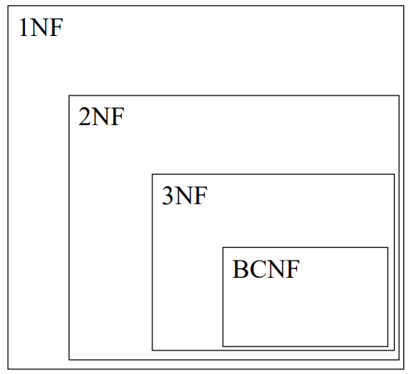
NORMALIZATION
There is a sequence to normal forms:
1NF is considered the weakest,
2NF is stronger than 1NF, 3NF is stronger than 2NF, and
BCNF is considered the strongest
Also,
any relation that is in BCNF, is in 3NF;
any relation in 3NF is in 2NF; and any relation in 2NF is in 1NF.

Slide 46
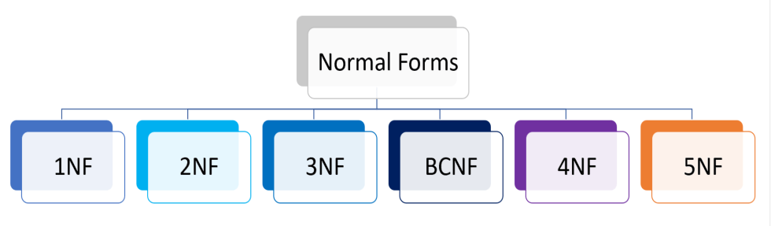
TYPES OF NORMALIZATION

Slide 47

First Normal Form
We say a relation is in 1NF if all values stored in the relation are single-valued and atomic. 1NF places restrictions on the structure of relations. Values must be simple.
The following is not in 1NF:
Name | Birth_date | Certifications | Certification 1 | Certification 2 | Certification 3
John | 1990/02/12 | PBI, MCSA, MTA | PBI | MCSA | MTA
Kelly | 1988/10/01 | Excel | Excel | NULL | NULL
Bryan | 1991/01/15 | PBI, Excel | PBI | Excel | NULL
Rob | 1986/08/07 | PBI | PBI | NULL | NULL
To obtain 1NF relations we must, without loss of information, eliminate repeating groups of data
or repeating columns + primary key.

Slide 48

First Normal Form
We say a relation is in 1NF if all values stored in the relation are single-valued and atomic. 1NF places restrictions on the structure of relations. Values must be simple.
Learner _ID | Name | Birth_date | Certification _ID | Certification _name | Vendor_ name | Date_acquir ed
1 | John | 1990/02/12 | 1 | PBI | Microsoft | 2017/01/08
1 | John | 1990/02/12 | 2 | MCSA | Microsoft | 2020/04/16
1 | John | 1990/02/12 | 3 | MTA | Microsoft | 2021/05/12
2 | Kelly | 1988/10/01 | 4 | Excel | Microsoft | 2018/06/03
3 | Bryan | 1991/01/15 | 1 | PBI | Microsoft | 2019/12/11
3 | Bryan | 1991/01/15 | 4 | Excel | Microsoft | 2020/04/07
4 | Rob | 1986/08/07 | 1 | PBI | Microsoft | 2022/01/15
An outer join between will produce the information we saw before

Slide 49

Second Normal Form
Note: If PK is set as a single then you don't need to do anything, the table is already in 2NF
A relation will be in 2NF if it is in 1NF.
All non-key attributes are fully functional dependent on the primary key.
Create separate tables for sets of values that apply to multiple records.
Relate these tables with a foreign key.
Learner_ID | Name | Birth_date
1 | John | 1990/02/12
2 | Kelly | 1988/10/01
3 | Bryan | 1991/01/15
4 | Rob | 1986/08/07
Learner_ID | Certification_ID | Date_acquired
1 | 1 | 2017/01/08
1 | 2 | 2020/04/16
1 | 3 | 2021/05/12
2 | 4 | 2018/06/03
3 | 1 | 2019/12/11
3 | 4 | 2020/04/07
4 | 1 | 2022/01/15
Certification _ID | Certification _name | Vendor_ name
1 | PBI | Microsoft
2 | MCSA | Microsoft
3 | MTA | Microsoft
4 | Excel | Microsoft

Slide 50

Third Normal Form
3NF satisfy all conditions of 2NF
A relation in 3NF will not have any transitive dependencies of non-key attributes on key
column must be removed.
Vendor_ID | Vendor_name
1 | Microsoft
2 | Amazon
Certification _ID | Certification _name | Vendor_ name
1 | PBI | Microsoft
2 | MCSA | Microsoft
3 | MTA | Microsoft
4 | Excel | Microsoft
Certification _ID | Certification _name | Vendor_I D
1 | PBI | 1
2 | MCSA | 1
3 | MTA | 1
4 | Excel | 1

Slide 52

Third Normal Form
Learner_ID | Name | Birth_date
1 | John | 1990/02/12
2 | Kelly | 1988/10/01
3 | Bryan | 1991/01/15
4 | Rob | 1986/08/07
Learner_ID | Certification_ID | Date_acquired
1 | 1 | 2017/01/08
1 | 2 | 2020/04/16
1 | 3 | 2021/05/12
2 | 4 | 2018/06/03
3 | 1 | 2019/12/11
3 | 4 | 2020/04/07
4 | 1 | 2022/01/15
Certification _ID | Certification _name | Vendor_I D
1 | PBI | 1
2 | MCSA | 1
3 | MTA | 1
4 | Excel | 1
Vendor_ID | Vendor_name
1 | Microsoft
2 | Amazon

Slide 53
Roles
PostgreSQL manages database access permissions using the
concept of roles.
A role can be thought of as either a database user, or a group of database users, depending on how the role is set up.
Roles can own database objects (for example, tables and functions) and can assign privileges on those objects to other roles to control who has access to which objects.
GRANT SELECT ON TABLE employees TO read_only;
Database roles are conceptually completely separate from operating system users.
In practice it might be convenient to maintain a correspondence,
but this is not required.

Slide 54
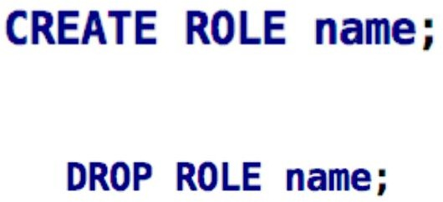

Roles
14
Database roles are global across a database cluster installation (and not per individual database). To create a role use the CREATE ROLE SQL command:
To determine the set of existing roles, examine the pg_roles system
catalog, for example

Slide 55

Role Attributes
15
A database role can have a number of attributes that define its privileges and interact with the client authentication system.

Slide 56
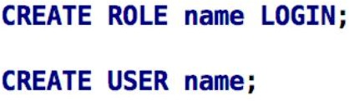
Login privileges
16
Only roles that have the LOGIN attribute can be used as the initial role name for a database connection.
A role with the LOGIN attribute can be considered the same as a
“database user”. To create a role with login privilege, use either:
CREATE ROLE analyst LOGIN PASSWORD 'password123';
CREATE USER analyst PASSWORD 'password123';

Slide 57
Superuser status
17
A database superuser bypasses all permission checks, except the right to log in.
This is a dangerous privilege and should not be used carelessly; it is best to do most of your work as a role that is not a superuser.
To create a new database superuser, use: CREATE ROLE name SUPERUSER
You must do this as a role that is already a superuser.

Slide 58
Database creation
18
A role must be explicitly given permission to create databases.
To create such a role, use: CREATE ROLE name CREATEDB
CREATE ROLE db_creator LOGIN PASSWORD 'secure_pass' CREATEDB;

Slide 59
Role creation
19
A role must be explicitly given permission to create more roles.
To create such a role, use:
CREATE ROLE name CREATEROLE
A role with CREATEROLE privilege can alter and drop other roles, too, as well as grant or revoke membership in them.
However, to create, alter, drop, or change membership of a superuser
role, superuser status is required;
CREATE ROLE role_manager LOGIN PASSWORD 'secure_pass' CREATEROLE;

Slide 60
Initiating replication
20
A role must explicitly be given permission to initiate streaming replication.
A role used for streaming replication must have LOGIN permission as well.
To create such a role, use:
CREATE ROLE name REPLICATION LOGIN

Slide 61
Password
21
A password is only significant if the client authentication method requires the user to supply a password when connecting to the database.
The password and md5 authentication methods make use of passwords.
Database passwords are separate from operating system passwords.
Specify a password upon role creation with: CREATE ROLE name PASSWORD 'string’
CREATE ROLE username LOGIN PASSWORD 'secure_password';

Slide 62
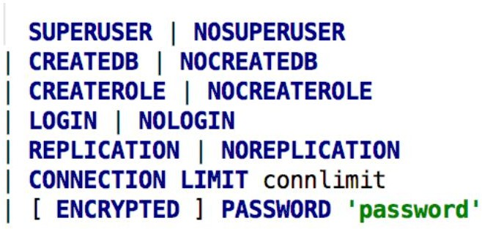
Modify role
22
A role's attributes can be modified after creation with ALTER ROLE
where option can be:

Slide 63
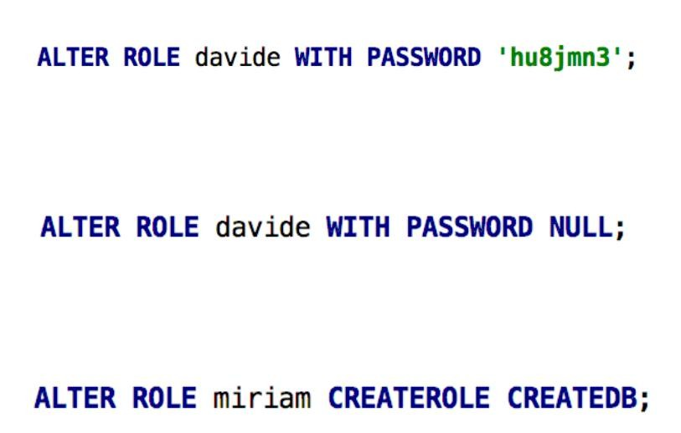
Examples
23

Slide 64
Role Membership
24
It is frequently convenient to group users together to ease management of privileges: that way, privileges can be granted to, or revoked from, a group as a whole.
In PostgreSQL this is done by creating a role that represents the group, and then granting membership in the group role to individual user roles.
CREATE ROLE developers;
GRANT CREATE ON DATABASE mydb TO developers;

Slide 65
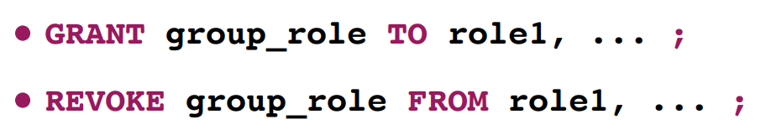
Role Membership
25
Once the group role exists, you can add and remove members using the GRANT and REVOKE commands:
GRANT developers TO user1; REVOKE developers FROM role1;
You can grant membership to other group roles, too (since there isn't
really any distinction between group roles and non-group roles).
GRANT developers TO managers;
The database will not let you set up circular membership loops.

Slide 66
Ownership
26
Ownership of objects can be transferred one at a time using ALTER commands, for example:
ALTER TABLE bobs_table OWNER TO alice;
Alternatively, the REASSIGN OWNED command can be used to reassign ownership of all objects owned by the role-to- bedropped to a single other role.
REASSIGN OWNED BY doomed_role TO successor_role; DROP OWNED BY doomed_role;
DROP ROLE doomed_role;

Slide 67
Database design
27
The problem of domain representation.
Logical design
Problems of poor database design:
  Possibility of recording non-valid data
  Possibility of information loss (no relations)

Slide 68
Stages of database design
28
Analyzing the requirements of the subject area
Logical modelling of the subject area data
Physical design and normalization

Slide 69
Logical modelling
30
Details the conceptual model of the database
Different sources include different components in the logical model
Fully describes all keys
Completely defines data types
Describes logical constraints
Normalization of relations usually to 3NF

Slide 70
Physical design and normalization
31
Selecting a specific DBMS
Defining data types
Defining indexes
Possible definition of views
Definition of access restriction (security)

Slide 71
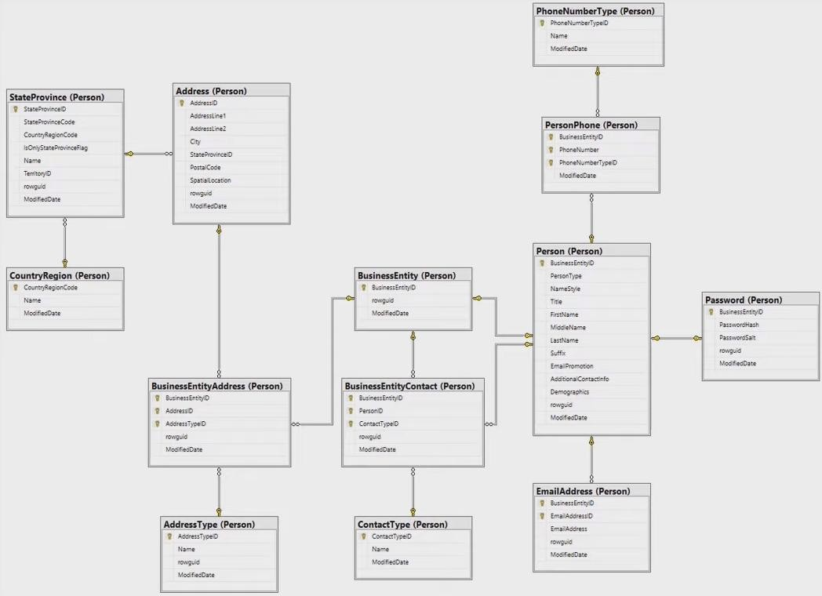
ER(Entity relationship) diagrams
32
Paid tools for modelling
MySQL Workbench
ORACLE SQL developer Data Modeler
pgModeler
SQL power Architect

Slide 72
Basic DB design tips
33
Table: object, event, abstraction
Field (column): property of the object.
Record (row): a set of fields
The values in each field individually must not contain non- valid data
The values in the set of fields must be consistent

Slide 73
Bad practices
34
Ignoring normalization leads to data redundancy
Lack of naming standards on the project.
One table for different types of data
Careless attitude to relevance of data
representation (domain may change).

Slide 74
Thank you for attention

